Slide 1
Extractive Text Summarization Hindi & Malayalam
Presented By :- 6961 . Sharon Philip

Slide 2
Index
1.Description
2.Features of Text Summarization
3.Components Used in Code
4.Architecture Diagram
5.Advantages of Text Summarization
6.Applications of Text Summarization
7. Conclusion

Slide 3
Description
Extractive Text Summarization is a technique in Natural Language Processing (NLP) that identifies and extracts key sentences or phrases from a given text to form a concise summary. Unlike abstractive summarization, which generates new text, extractive summarization selects the most relevant sentences without altering the original content. It relies on methods like word frequency analysis, positional importance, and machine learning models to determine which sentences contribute the most meaningful information. This technique is commonly used for summarizing articles, news reports, research papers, and other lengthy documents where quick insights are needed.

Slide 4
Features of Text Summarization
NLP enables computers to understand, interpret, and generate human language. Some key features include:
Tokenization: Breaking text into words, phrases, or sentences.
Stop word Removal: Filtering out common words like "the," "is," "and" that don’t add meaning.
Stemming & Lemmatization: Reducing words to their root form (e.g., "running" → "run").
Named Entity Recognition (NER): Identifying entities like names, dates, and locations.
Part-of-Speech (POS) Tagging: Classifying words as nouns, verbs, adjectives, etc.
Syntax Parsing: Analyzing grammatical structure.
Sentiment Analysis: Determining emotions or opinions in text.
Word Embeddings: Representing words as numerical vectors for machine learning models.
Text Classification: Categorizing text into predefined labels.
Summarization: Generating concise versions of longer texts (either extractive or abstractive).

Slide 5
Components Used in Code
To implement extractive text summarization using Python and spaCy, the following components are used:
Text Input: User-provided text that needs to be summarized.
Tokenization: Splitting text into words and sentences.
Stop word Removal & Punctuation Filtering: Removing unnecessary words to focus on key content.
Word Frequency Calculation: Identifying important words based on their occurrence in the text.
Sentence Scoring: Assigning scores to sentences based on word importance.
Sentence Selection: Choosing the highest-scoring sentences for the summary.
GUI (Tkinter): Providing an interface for users to input text and receive a summary.

Slide 6
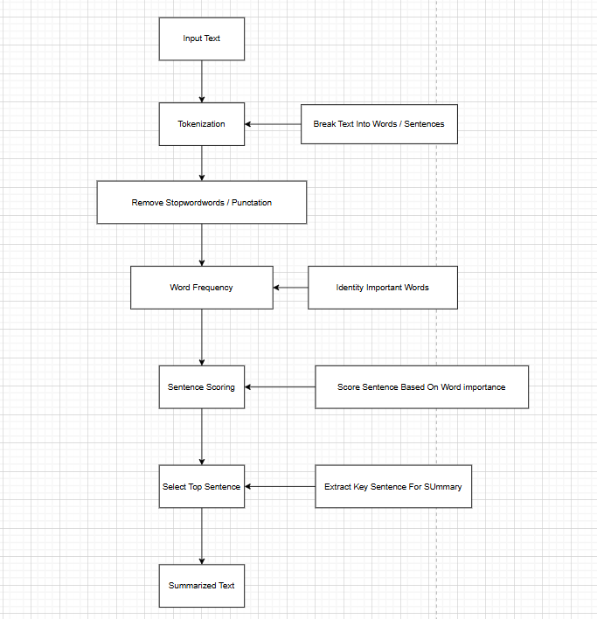
Architecture
Diagram

Slide 7
Advantages of Text Summarization
Time-Saving: Quickly extracts important information, reducing reading time.
Improves Efficiency: Useful for summarizing large volumes of text (news, reports, research papers).
Consistency: Provides uniform summaries without human bias.
Automation: Can be integrated into AI systems for real-time summarization.
Customizable: Can be fine-tuned based on specific needs (e.g., adjusting summary length).

Slide 8
Applications of Text Summarization
News Summarization: Extracting key points from news articles.
Research Paper Summarization: Condensing academic papers into short summaries.
Legal Document Processing: Summarizing lengthy legal texts for quick reference.
Chatbot & Virtual Assistants: Providing summarized responses from large documents.
Business Reports: Generating executive summaries from reports.
Medical Records Analysis: Summarizing patient histories for doctors.
Social Media Monitoring: Extracting main points from social media trends.
E-Learning & Education: Summarizing textbooks and study materials.

Slide 9
Conclusion
Extractive Text Summarization is a powerful NLP technique that enhances information processing by automatically extracting key sentences from a given text. It is widely used in industries like journalism, healthcare, education, and business to improve efficiency and decision-making. With advancements in deep learning, modern NLP models are making summarization more contextually accurate and human-like. However, extractive summarization may sometimes lack coherence since it retains exact sentences. Future developments in hybrid models (combining extractive and abstractive methods) will further improve summary quality and readability.

Slide 10
THANK YOU

